Slide 1


IDENTIFICATION OF PEOPLE AT RISK OF RADICALIZATION

Slide 2

PROBLEM STATEMENT
· Terror recruiters regularly scour social media platforms looking for people to join their cause.
· In particular, they look for people who express fanatical and intense views online, or perceive themselves as victims of oppression or injustice. Once identified, terror recruiters slowly start brain-washing such people into joining terror outfits. The impact of this for their innocent families and the nation is catastrophic.
· Being able to identify such vulnerable people in a timely manner is therefore crucial. Once identified, adequate steps such as counselling and intervention may be initiated to prevent them from being led astray by terror recruiters.
· The task is to build a solution that can analyze social media posts in the format of text, pictures and videos by a person and determine the person’s proclivity to getting radicalized.
· The idea is to throw alerts if the chances of radicalization are perceived as high, and beyond a certain threshold.

Slide 3
PROBLEM STATEMENT
· There is a lot of hate content being circulated online on social media platforms and messaging apps that threaten to disrupt harmony in our society and flare up tensions. For example, inciting hatred against a particular community/ religion/ person etc.
· Such posts could be in the form of text, photos, videos, or audio messages, that evoke anger and hatred, and tend to influence people negatively against something or someone.
· From a law enforcement perspective, it is critical that such posts are identified quickly so as to prevent untoward law and order problems.
· The primary objective of this problem statement is to explore content in social media platforms and highlight posts that promote hatred.

Slide 4

Solution& Implementation
01
Unique Advantages
Support Needed
02
03
Describes the solution of the problem
Describes the unique advantages
Describes the support needed.

Slide 5
SOLUTION & IMPLEMENTATION
01
Describes the solution of the problem

Slide 6
STEPS INVOLVED IN SOLUTION
The profile of the person in question is fetched using the profile URL.
Profile URL
Fetches the Posts
All the posts of the person are stored in a database.
Performs the visualization of the fetched data.
Visualization
Analysis & Result
Performs sentiment analysis on the data and generates a suitable result accordingly

Slide 7

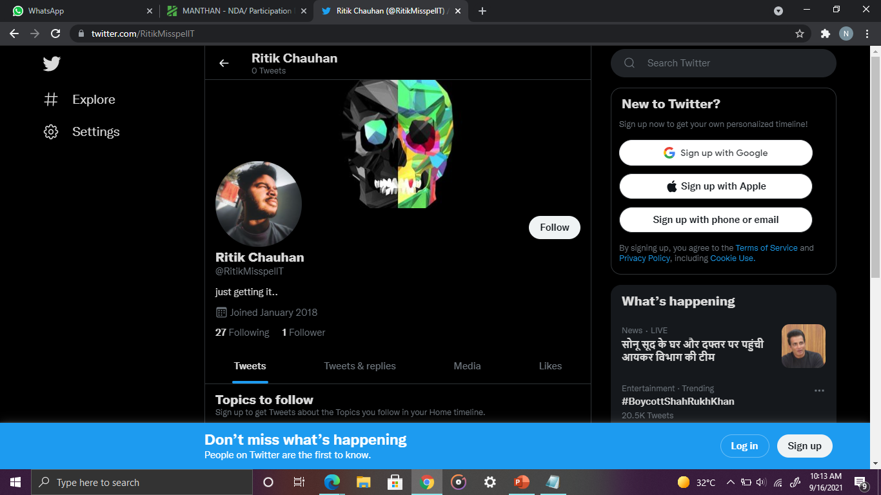
Fetching of the Profile
The URL of the profile of the person in question is provided by the user. All the posts in the profile and the list of the users the person is following are stored in a local database. The following list and the posts are fetched using Twitter API v2.

Slide 8
DATA VISUALIZATION
Visualized Data
Divided the data into three sections
The text posts section
Picture posts section
Video posts section
Result
The result we found was that the text posts constitutes the majority of the data while videos were in the minority of the data.

Slide 9
DATA VISUALIZATION
Visualized Data
Visualized the following list of users
Following list is distinguished on the basis of gender of the user
Result
The result we found was that the male users constitutes the majority of the data in the following list of male users while females were in the majority of the data in the following list of female users.

Slide 10
Potential Risk Factors for Groups of People
·Having a History of Criminal Violence
·Having a Criminal History
·Having Been Involved With a Gang or Delinquent Peers
·Having a Terrorist Friend
·Being a Member of an Extremist Group for an Extended Period
·Having a Deep Commitment to an Extremist Ideology
·Having Psychological Issues
·Being Unemployed
·Having a Sporadic Work History
·Having Less Education
·Having a Lower Social Economic Status
·Failing to Achieve One’s Aspirations
·Having Trouble in Romantic Relationships
·Having Trouble in Platonic Relationships
·Having Been Abused as an Adult
·Being Distant From One’s Family

Slide 11
Potential Risk Factors for an Individual
·Having a Criminal Record
·Having Personal & Political Grievances
·Having Received a Diagnosis of Schizophrenia or Delusional Disorder
·Having an Enabler
·Being Unemployed
·Having at Least a Bachelor’s Degree
·Being Socially Isolated
·Being Single
·Living Alone
·Having Military Experience
·Being Male

Slide 12
SENTIMENT ANALYSIS OF POSTS
PHOTO ANALYSIS
Runs an algorithm that performs analysis on pictures
TEXT ANALYSIS
· Lexicon based approach
· Automated approach
· Hybrid approach
VIDEO ANALYSIS
· Event Analysis
· Speech Analysis

Slide 13
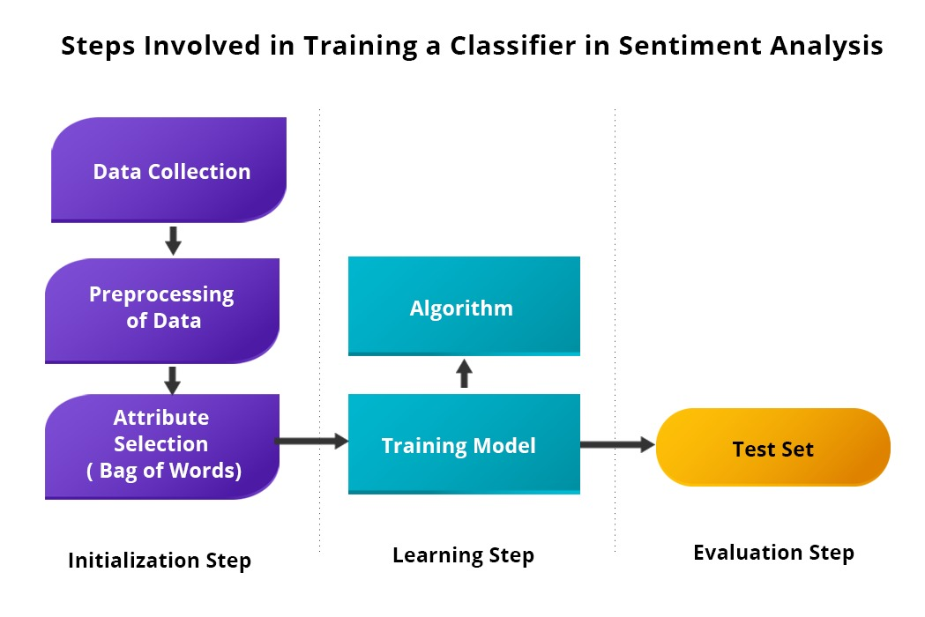
Lexicon Based Approach on Text Analysis
This approach relies on manually crafted rules for data classification to determine sentiment. This approach use dictionaries of words with positive or negative values to denote their polarity and sentiment strength to calculate a score. Additional functionality can also be added by including expressions. Rule based sentiment analysis algorithms can be customized based on context by developing even smarter rules.
How it works: It counts the number of positive and negative words in the given text. If the number of positives is more than the negatives, it will return a positive sentiment. If both are equal, it will return a neutral sentiment.

Slide 14
Lexicon Based Approach on Text Analysis
Disadvantages of this approach:
The downside of this approach is that it does not take into account how the words are combined in a sentence, it only looks at occurrences.
It is quick to implement but the model involves a long-term cost outlay as it requires regular maintenance so that you get consistent and improved results.

Slide 15
Automated Approach on Text Analysis
In this approach, instead of clearly defined rules, this sentiment analysis model uses machine learning to figure out the essence of the statement.
This ensures that the exactitude of the analysis improves and information can be processed on many criteria without it being too complicated.
This approach involves the use of machine learning algorithms under supervision.
An algorithm is trained with many sample passages until it can predict with accuracy the sentiment of the text.
Then large pieces of text are fed into the classifier and it predicts the sentiment as negative, neutral or positive.

Slide 16
Hybrid Approach on Text Analysis
Hybrid sentiment analysis models are the most modern, efficient, and widely-used approach for sentiment analysis.
Provided you have well-designed hybrid systems, you can actually get the benefits of both automatic and rule-based systems.
Hybrid models can offer the power of machine learning coupled with the flexibility of customization.

Slide 17
PICTURE ANALYSIS
For picture sentiment analysis, we considered using ANP (Adjective Noun Pairs). ANP is a visual representation that describes
visual features by text pairs, such as “cloudy sky”, “colorful flowers”, etc. It is formed by merging the low-level visual features to the detected mid-level objects and mapping them to a dictionary. On the other hand, to learn the image’s context, we analyze the image’s textual description and capture its sentiment based on sentiment lexicons.
Visual Sentiment In addition to the prior knowledge on lexicon, our second prior knowledge comes from the Visual Sentiment Ontology (VSO) which is based on the well known previous researches on human emotions and sentiments Darwin (1998); Plutchnik (1980). It generates 3000 ANPs using Plutchnik emotion model and associates the
sentiment strength (range in[-2:2] from negative to positive) by a wheel emotion interface 3.

Slide 18
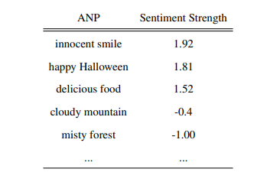
PICTURE ANALYSIS

Slide 19
VIDEO ANALYSIS
Fetches the video post from the given user’s database.
Fetches the video from the same user’s database.
EVENT ANALYSIS
SPEECH ANALYSIS
EVENT ANALYSIS
SPEECH ANALYSIS
Performs event analysis on the fetched video to generate the happening event and runs lexicon approach to check the sentiment.
Performs speech analysis on the fetched video to convert speech to text and then runs text analysis on the generated text using previously discussed approaches.

Slide 20


RESULTS OBTAINED FROM ANALYSIS

Slide 21
RESULTS & RQ
For each negative sentiment result, we decide the corresponding increase in RQ value.
We set a threshold value for sentiments. Until or unless, the sentiment result does not exceed that particular value, we will not increase the RQ value.
We keep on doing that until our sentiment results are not finished.
When the RQ exceeds a certain threshold (for example 70%), we throw an alert and later that information can be used in determining appropriate measures to deal with the situation.

Slide 22
UNIQUE ADVANTAGES
02
Describes the unique advantages of the idea.

Slide 23
WHAT SETS US APART?
Picture & Video Analysis
Radicalization Factor
Thorwing Alerts
Rather than just doing sentiment analysis on the posts, we generate RQ score as well to determine the person’s proclivity to getting radicalized.
Apart from the traditional text analysis of sentiments, this idea also inlcudes visual implementation of sentiment analysis.
Rather than just calulting a mere number, we also plan to throw alerts for the same if that mere number exceeds a certain theshold value.

Slide 24
SUPPORT NEEDED
03
Describes the support needed for the idea.

Slide 25
SUPPORT NEEDED
01 | 02 | 03 | 04
Industry Experts and Experienced Mentors | A supportive and enthusiastic Team | A proper workspace and workstation | Courses and tools for the same

Slide 26
THANK YOU!
Do you have any questions?
princelegend130@gmail.com
+91 7988708484
NIKSHIT MONGA

